Slide 1

2024 Spring SOCI2010 (Education and Society) Tutorial 9
Wanying LING
Department of Sociology
The University of Hong Kong
lingwany@connect.hku.hk
Apr 10, 2024

Slide 2
Updated Tutorial Schedule
Dates | Tutorial
T1 (Jan 31) | • Form groups. • Kick off the group project. • Select an article and start reviewing.
T2 (Feb 7) | • Summarise the article • Sharing topics of interest
T3 (Feb 21) | • Discuss the RQ/hypotheses. • Discuss data collection/analysis methods.
T4 (Feb 28) | • Finalise the RQ/hypotheses. • Discuss data collection/analysis methods.
T5 (Mar 13) | • Discuss data collection/analysis methods. • Finalise data collection/analysis methods.
T6 (Mar 20) | • Sharing of experiences and issues in data collection/data cleansing
T7 (Mar 27) | • Analyse the data - Qualitative (interviews) and quantitative (Descriptive Statistics)
T8 (Apr 3) | • Analyse the data
T9 (Apr 10) | • Analyse the data – demonstration; Discussion of Implications
T10 (Apr 17) | • Prepare presentation slides.
T11 (Apr 24) | • Presentation.

Slide 3
Presentation
20 minutes
It should include:
Literature Review
Describe the research article that is closest to your project; if there is more than one, summarise the relevant content of more than one.
Research Questions and Hypotheses
Data (Collection and) Analysis
Findings and Discussion
Balanced Division of Labour

Slide 4
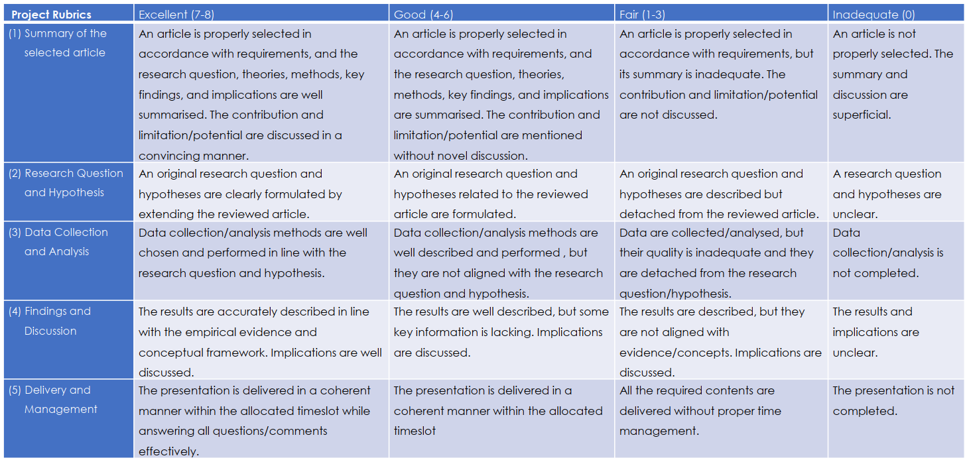
Grading

Slide 5
Research Implications
What?
Why?
Notes:
Let's start with the basics: What exactly are research implications? Simply put, they are the effects or consequences that your research may have on the field of education, policy, and practice. They answer the "So what?" question of your research.
Why are they important? Because without them, our research could remain confined to academic journals, never reaching the classrooms, policy discussions, or educational institutions where change can be made.

Slide 6
Types of Implications
Practical Implications
Theoretical Implications
Policy Implications
Notes:
Practical implications are the direct applications of your findings. For instance, if your research discovers that students from minority backgrounds feel underrepresented in the curriculum, a practical implication might be to develop a more inclusive curriculum that reflects a diverse range of histories and perspectives.
Theoretical implications pertain to the realm of ideas. Let's say your research supports the theory that peer collaboration enhances learning outcomes. This finding strengthens sociocultural theories of learning and suggests that educators should incorporate more group work into their teaching strategies.
Policy implications involve how your research might inform or reshape educational policies. Imagine your study reveals that standardized testing disproportionately disadvantages students from lower socioeconomic backgrounds. This could lead to policymakers re-evaluating the fairness and effectiveness of these tests.

Slide 7
Identifying Implications
Revisit Your Research Questions
01
Examine Your Findings
02
Consider Broader Effects
03
Notes:
Now, identifying these implications involves looking closely at your research questions and findings. Consider the broader effects and who might be affected by your research.

Slide 8
Practical Implications
Application in Practice
Direct ways your research can be implemented.
Recommendations for Educators
Specific advice or strategies for teachers, administrators, and other stakeholders.
Future Interventions
Potential programs or interventions that could be developed based on your findings.

Slide 9
Theoretical Implications
Contribution to Knowledge
How your research fills gaps or adds to the sociological understanding of education.
Modifying Existing Theories
How your findings support or challenge current theories.
Groundwork for Future Research
Suggest areas where further investigation is needed.

Slide 10
Policy Implications
Influencing Policy
How research can shape educational policies.
Advocacy
Using research to advocate for change in educational systems.
Long-Term Impact
Considering the potential long-term societal benefits or consequences of implementing your findings in policy.

Slide 11
Communicating Implications
Clarity and Conciseness
Audience Awareness
Avoid Overgeneralization
Notes:
Communicating these implications is as important as identifying them. Be clear and concise, and ensure that your audience, whether they are fellow scholars, educators, or policymakers, can understand and see the value of your work.

Slide 12
Common Pitfalls
Overstating Results
Avoid making claims that are not supported by your data.
Ignoring Negative Outcomes
Address potential negative implications of your findings.
Lack of Evidence
Ensure that your implications are firmly rooted in your research evidence.
Notes:
However, beware of common pitfalls such as overstating results, ignoring negative outcomes, or basing implications on insufficient evidence. Always ensure that your claims are supported by your data.
As you embark on your projects this term, remember that your research has the power to influence and inspire change. I encourage you to think deeply about the implications of your work and how it can contribute to a better understanding and improvement of education.

Slide 13
Analysing Data Using SPSS (Demonstration)

Slide 14
Next Tutorial
Discuss the presentation with your peers
Complete slides and submit it at the end of the tutorial

Slide 15
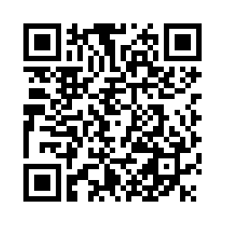
Tell me! (Please remember to select the corresponding date)
https://hku.au1.qualtrics.com/jfe/form/SV_0CAc6wAIyoTfH4W

Slide 16

Thank you!
Wanying Ling
lingwany@connect.hku.hk

